Slide 1
Summary
This RF design aims at building a SA extender which can down convert a high frequency signal, for example 60 GHz, to the frequency below 40 GHz (The frequency that SA can handle).
In the first step, we searched the proper mixer from over 20 RF manufacturers. In summary, there are three types: 1) Mixer module with coaxial connector; 2) Mixer die and 3) Mixer module with waveguide port. We prefer to use the first two mixer without any waveguide.
(Detailed in page )
In the second step, we focused on designing the boards which can offer proper LO signal for the mixers that we have determined to use. Until now, we have prepared two detailed solutions: 1) A complex solution but compatible for two different mixers (M9D-2065 and HMC-MDB218); 2) A simple solution but only works for the mixer module (M9D-2065). In both design, we carefully thought about the frequency and power level in the whole LO path.
In the third step, we start from the easier solution, create schematic and footprint library for each components in the Altium designer. Then draw the schematic based on the suggested circuits in their datasheets. For the layout, we probably need some full wave simulation as a guide for routing.

Slide 2
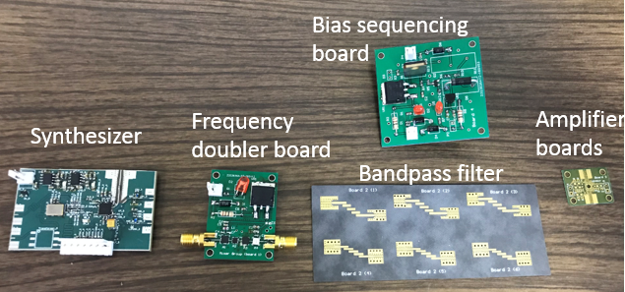
PCBs

Slide 3
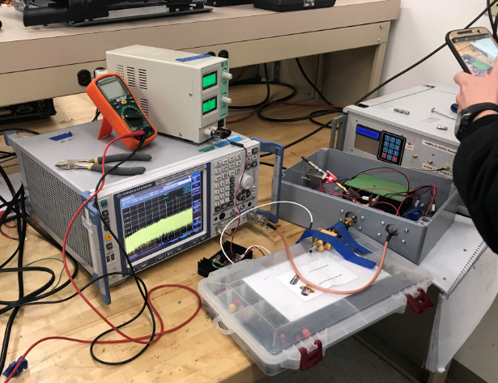
Testing Set-up
LO signal generator (added 6 dB attenuator)
Down conversion module
SA
High frequency signal generator

Slide 4
Selection of the mixers

Slide 5
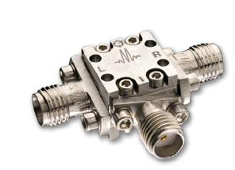
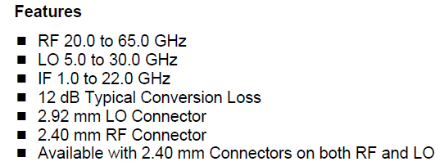
1) Mixer Module with coaxial connector
The following table lists all proper (RF goes higher than 50 GHz) coaxial connecter mixer module that we find:
Model No. | Price (USD) | RF (GHz) | LO (GHz) | IF (GHz) | Level (dBm) | Feature
MM1-2567LS | 1000 | 25~67 | 25~67 | DC~30 | 6~12 | Double balanced
M9D-2065 | 1225 | 20~65 | 5~30 | 1~22 | 18~21 | Sub-harmonic pumped
M9-0465 | 1150 | 4~65 | 4~65 | DC~3 | 14~18
M4-0165 | 1301 | 1~65 | 1~65 | DC~4 | 10~13
We are going to use it mainly because the required LO frequency is relative low
M9D-2065

Slide 6
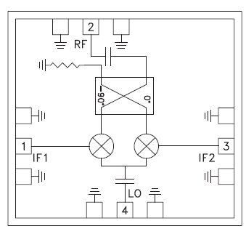
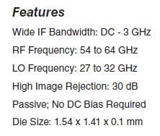
2) Mixer die
We can only find the proper (RF goes higher than 50 GHz) mixer die from Analog Device. The following is their options:
Model No. | Price (USD) | RF (GHz) | LO (GHz) | IF (GHz) | Level (dBm) | Feature
HMC1081 (die) | 62.14 | 50~75 | 40~85 | 0~26 | 12 | Double balanced
HMC-MDB218 (die) | 46 | 54~64 | 27~32 | 0~3 | 10 | Sub-harmonic, image rejection
HMC-MDB169 (die) | 27.27 | 54~65 | 54~64 | 0~5 | 13
We are going to use it mainly also because the required LO frequency is relative low
HMC-MDB218

Slide 7
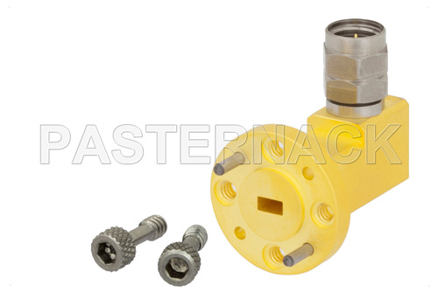
3) Waveguide Mixer
Typical RF frequency range of this type mixer covers from 18 to 110 GHz. There are many subharmonic pumped products in the market:
Vender | Price (USD) | RF (GHz) | LO (GHz) | IF (GHz) | Level (dBm) | Port type
Ducommun | N/A | 50~75 | 25~37.5 | DC~12 | 18 | WR-15
Cernex | N/A | 50~75 | 25~37.5 | DC~5 | 10~15 | WR-15
Farran | N/A | 50~75 | 25~37.5 | 0.01~6.5 | 7~13 | WR-15
But the waveguide port to coaxial connector adaptor is expensive

Slide 8
Solutions for LO path

Slide 9
Analysis
We consider to design a LO path works for two different mixer:
For the module mixer (M9D-2065), its IF supports a wide frequency range 1-22 GHz, which is larger than the RF range 50-65 GHz. It means the LO frequency can be fixed, for example, 24 GHz, when the RF changes from 50 to 65 GHz, the IF output changes from 2 to 17 GHz.
For the die mixer (Subharmonic Mixer HMC-MDB218), the LO frequency we need to use is 27 GHz to 30.5 GHz. The LO frequency has to be swept because the IF range is DC-3 GHz, the range is less than the RF range.
Based on the same design,
In the case of mixer die, we use the ADF5355 board RF output B (sweep from 6.8 to 7.625 GHz);
For the mixer module, we use the ADF5355 board RF output A (fixed at 6 GHz).

Slide 10
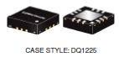
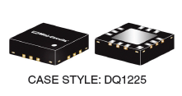
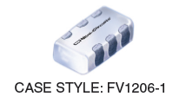
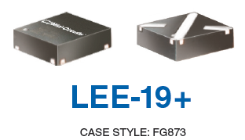
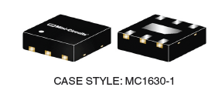
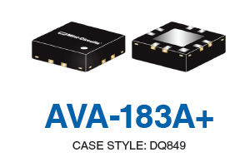
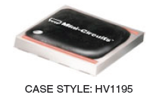
Design for providing LO signal
ADF5355 Board
RF output A: 54MHz-6.8GHz
(fixed at 6 GHz for example)
RF output B:6.8-13.6GHz
Typical output power: -5dBm (measured by ourselves)
Amplifier
LEE-19+
DC to 8 GHz
Gain: +10 dB
P1dB: 12 dBm
Amplifier
PMA3-83LN+
0.5 to 8 GHz
Gain: +19 dB
P1dB: 17 dBm
Lowpass filter
XLF-63+
DC~8.1 GHz
Passband insertion loss: 2 dB
Stopband rejection >12 dB
Highpass filter
HFCN-4400+
5~9.9 GHz
Passband insertion loss: 2 dB
Stopband rejection >20 dB
ADF5355 Board
Supply voltage 3.5 V
Supply voltage 5 V
Highpass filter
XHF2-1162+
10.4 ~ 30 GHz
Passband insertion loss: 3 dB
Stopband rejection >12 dB
Lowpass filter
XLF-133+
DC~15.8 GHz
Passband insertion loss: <3 dB
Stopband rejection >13 dB
Amplifier
AVA-183A+
5 to 18GHz
Gain: +14 dB
P1dB: 19 dBm
Multiplier
KSX2-24+
Input: 5-10 GHz, 10-16 dBm
Output: 10-20 GHz
Conversion Loss: 11.5-15 dB
Supply voltage 5 V
Choice #1:
Supply voltage 5 V
(Die) Subharmonic Mixer HMC-MDB218
LO 27-32 GHz, 10dBm
RF 54-64 GHz
IF DC-3GHz
Conversion loss: 12.5-14dB
Multiplier
HMC578LC3B
Input: 11.5-16.5 GHz, 0-6 dBm
Output: 23 -33 GHz, >10 dBm
Amplifier
TGA2521-SM
17 to 24GHz
Gain: 20 dB
P1dB: 23 dBm
Choice #2:
Supply voltage 5 V
or
or
Amplifier
AVA-183A+
5 to 18GHz
Gain: +14 dB
P1dB: 19 dBm
Multiplier
CY2-44+
Input: 6.2-20 GHz, +12-+18 dBm
Output: 12.4-40 GHz
Conversion Loss: 14dB
Amplifier
TGA4544-SM
26 to 31GHz
+23 dB
(Module) M9D-2065
RF 20-65GHz
LO 5-30 GHz, 18-21dBm
IF 1-22GHz
12 dB Typical Conversion Loss
Those amplifiers fail to cover a wide frequency range, to combine to solutions, the LO frequency range should include 24~31 GHz.
This part will be detailed discussed in next page

Slide 11
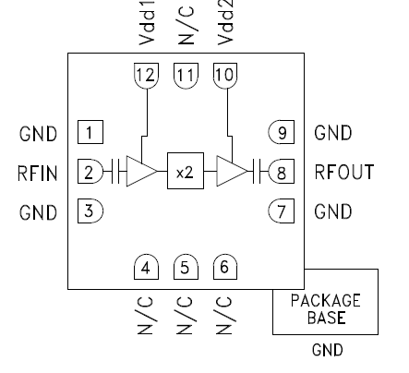
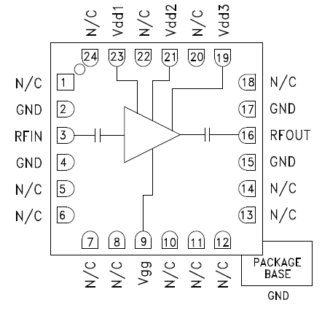
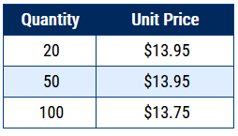
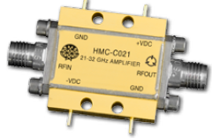
If the HMC499LC4 can be used
Advantage: cover the frequency from 21 to 32 GHz which suitable for each case; Also P1dB is high enough
(Die) Subharmonic Mixer HMC-MDB218
LO 27-32 GHz, 10dBm
RF 54-64 GHz
IF DC-3GHz
Conversion loss: 12.5-14dB
Choice #1:
Unit price: $55.23
Minimal quantity: 1
Multiplier
HMC578LC3B
Input: 11.5-16.5 GHz, 0-6 dBm
Output: 23 -33 GHz, >10 dBm
Self-design Bandpass filter
Amplifier
HMC499LC4
21 to 32GHz
Gain: +16 dB
P1dB: 20dBm
or
(Module) M9D-2065
RF 20-65GHz, Input 1 dB Compression 0 dBm
LO 5-30 GHz, 18-21dBm
IF 1-22GHz
12 dB Typical Conversion Loss
Supply voltage +5 V
RoHS Compliant 3x3 mm SMT Package
Minimal purchase quantity: 20
Also cannot find it from DigKey and Mouer
(Die) Subharmonic Mixer HMC-MDB218
LO 27-32 GHz, 10dBm
RF 54-64 GHz
IF DC-3GHz
Conversion loss: 12.5-14dB
Choice #2:
Supply voltage +5 V
Negative bias: -2 ~0V
Supply voltage 5 V
Amplifier
AVA-183A+
5 to 18GHz
Gain: +14 dB
P1dB: 19 dBm
Multiplier
CY2-44+
Input: 6.2-20 GHz, +12-+18 dBm
Output: 12.4-40 GHz
Conversion Loss: 14dB
Self-design Bandpass filter
Amplifier
HMC499LC4
21 to 32GHz
Gain: +16 dB
P1dB: 20dBm
Amplifier
HMC499LC4
21 to 32GHz
Gain: +16 dB
P1dB: 20dBm
or
Or use amplifier modules (will be expensive)
HMC-C021
Frequency: 21-31 GHz
Gain: 15 dB
P1dB output power: +24 dBm
(Module) M9D-2065
RF 20-65GHz
LO 5-30 GHz, 18-21dBm
IF 1-22GHz
12 dB Typical Conversion Loss

Slide 12

Availability
EZ in the following table means that we can get some samples for free.
Component | Unit price | number | Total price
First amplifier: LEE-19+ | $1.35 | minimal x20 or EZ | TBD
Second amplifier: PMA3-83LN+ | $11.95 | minimal x20 or EZ
First lowpass filter: XLF-63+ | $10.95 | minimal x20 or EZ
First highpass filter: HFCN-4400+ | $2.99 | minimal x20 or EZ
First multiplier: KSX2-24+ | $12.95 | x2
Second amplifier: AVA-183A+ | $8.95 | minimal x20 or EZ
First lowpass filter: XLF-133+ | $10.95 | minimal x20 or EZ
First highpass filter: XHF2-1162+ | $11.95 | minimal x20 or EZ
(Choice #1)The second multiplier: HMC578LC3B | $55.23 | x2
Third amplifier: HMC499LC4 | $58.58 | x2
Connecters | TBD | TBD
PCB | TBD | TBD
Enclosure | TBD | 1x2
Wire bounding for die | TBD (expensive) | 1x2
Mixer die: HMC-MDB218 | $46 | 1x2
Mixer module: M9D-2065 | $1225 | 1x1

Slide 13

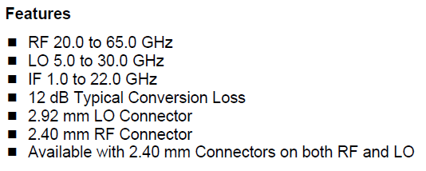
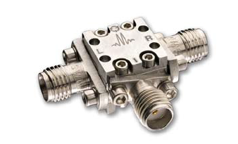
The reason of fixing LO frequency
The IF support a wide frequency range from 1 to 22 GHz. The input RF frequency is from 20 GHz to 65 GHz. For the RF, if we only care about the frequency higher than 50 GHz, then the RF variable range 15 GHz is smaller than 21 GHz. Therefore, we can fix the LO frequency, e.g. 24 GHz. In this case, the IF output varying from 2 GHz to 17 GHz corresponds to RF from 50 GHz to 65 GHz.
If the LO frequency is fixed to 24GHz, the input of the multiplier should be 12GHz, which is within the output frequency range of ADF5356 (6.8-13.6GHz).

Slide 14
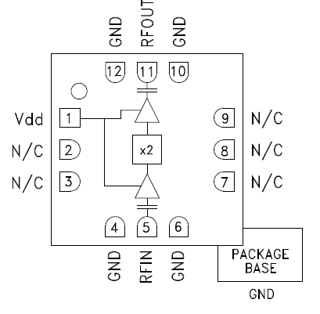
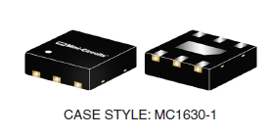
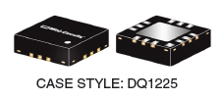
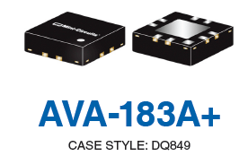
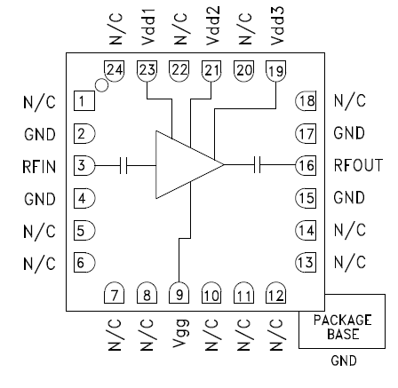
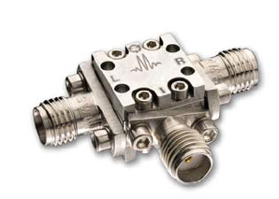
ADF5355 Board
RF output B:6.8-13.6GHz
Fixed at 12 GHz (for example)
Typical output power: -5dBm (measured by ourselves)
We don’t have many choices from mini-circuit. This amplifier works for frequency higher than 5 GHz should be better than those work from DC.
No suitable bandpass filter from Mini circuit
Unit price: $56.37
Minimal quantity: 1
Amplifier
AVA-183A+
5-18GHz
Gain: 14dB
1dB compression: 19dBm
Highpass Filter
XHF2-1162+
10.4(cut-off) to 30GHz
Passband loss: <3 dB
Stopband loss: >12 dB
Lowpass Filter
XLF-123+
DC to 15 GHz (cutoff)
Passband loss: <3 dB
Stopband loss: >14 dB
Multiplier
HMC448LC3B
Input: 10-12.5GHz, -4~6dBm
Output: 20-25GHz, 11dBm
ADF5355 Board
RoHS Compliant 3x3 mm SMT Package
Power supply: +5V
Advantage:
1) The frequency range is narrow, possible to get rid of some harmonics
2)Active component, the output power is high.
RoHS Compliant 3x3 mm SMT Package
Power supply: +5V
[Mini circuit] Amplifier
AVM-273HP+
13-26.5GHz
Gain: 14dB
P1dB : 26.5 dBm
Unit price $27.95 (Minimal number:10)
Bias sequence is needed
[Analog] Amplifier
HMC499LC4
17-24GHz
Gain: 22dB
P1dB: >22dBm
Unit price $62.62 (Minimal number:1)
Self designed bandpass filter
or
Frequency goes up to 20 GHz, there is no suitable filter from Mini circuit.
Supply voltage +5 V
Negative bias: -2 ~0V
LO
(Module) M9D-2065
RF 20-65GHz
LO 5-30 GHz, 18-21dBm
IF 1-22GHz
12 dB Typical Conversion Loss
In this design, the multiplier comes from Analog, we think it is suitable. The mini circuit have two similar products but their minimal purchase quantity is 20 and no free sampler can be applied.

Slide 15
Availability
Component | Unit price | number | Total price
First amplifier: AVA-183A+ | $8.95 | minimal x10 or EZ | TBD
First lowpass filter:XLF-123+ | $10.95 | minimal x20 or EZ
First highpass filter: XHF2-1162+ | $11.95 | minimal x20 or EZ
First multiplier: HMC448LC3B | $48.48 | x2
Second amplifier: HMC499LC4 | $49.36 | x2
Connecters | TBD | TBD
PCB | TBD | TBD
Enclosure | TBD | x1
Mixer module: M9D-2065 | $1225 | 1x1
EZ in the following table means that we can get some samples for free.

Slide 16
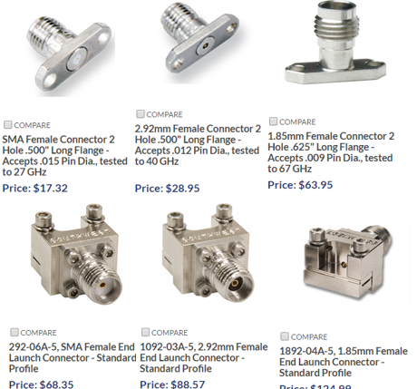
Connectors and boards
For the first LO path solution, at low frequencies, SMA and FR4 boards are OK.As the frequency goes high (around 30 GHz), we have to think about some special connectors and Roger 5880 boards.
For the second LO path solution, the highest frequency only goes to 24 GHz, FR4 and common SMA connector may be fine.
we prefer the second solution.

Slide 17
The self designed bandpass filter

Slide 18
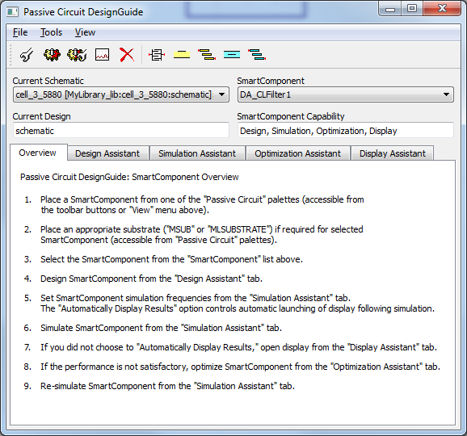
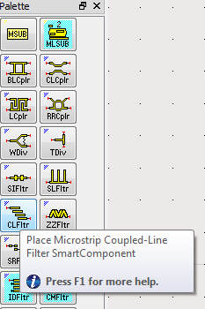
Design of Microstrip Edge Coupled Line Filter using ADS
First place the smart component

Slide 19
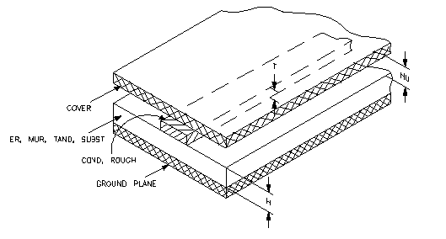
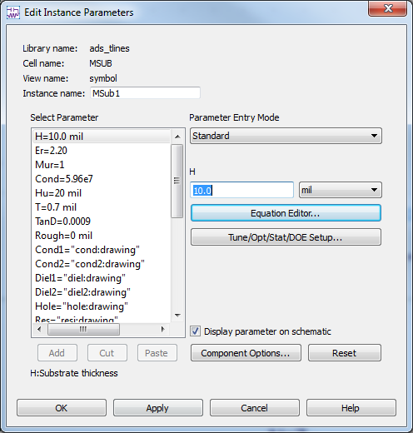
Edit the Substrate
H: Substrate thickness
Er: Relative dielectric constant
Mur: Relative permeability
Cond: Conductor conductivity
Hu: Cover height
T: Conductor thickness
TanD: Dielectric loss tangent
RT/duroid 5880 are used

Slide 20
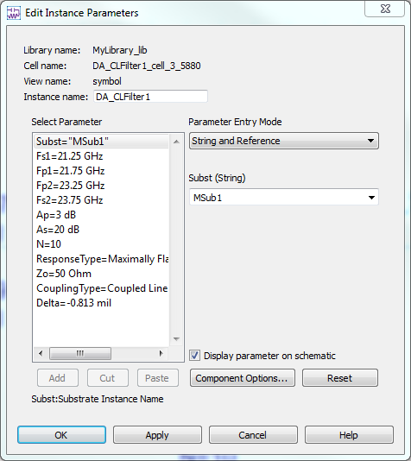
Set the design restrictions
Fs1: Lower stopband edge frequency
Fp1: Lower passband edge frequency
Fp2: upper passband edge frequency
Fs2: lower stopband edge frequency
N: number of filter sections
Zo: desired input/output impedance

Slide 21
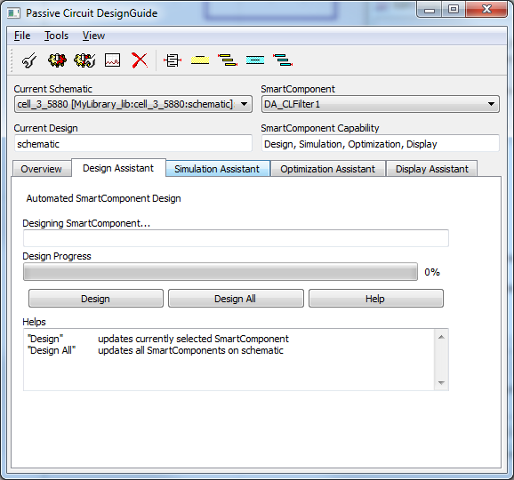
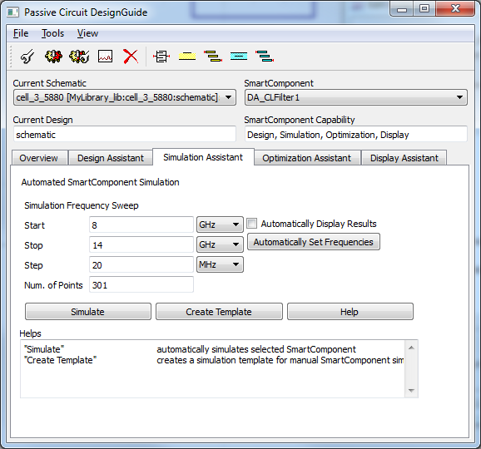
Design and Simulate

Slide 22
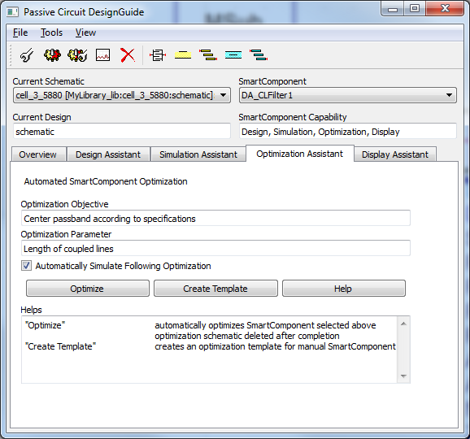
Optimize

Slide 23
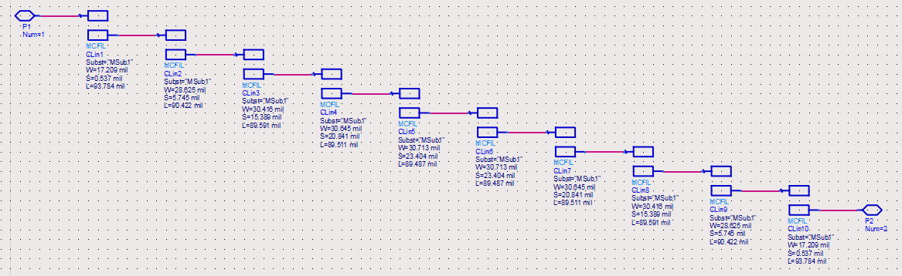
Final Design in ADS
The total length of this filter is about 2.5cm

Slide 24
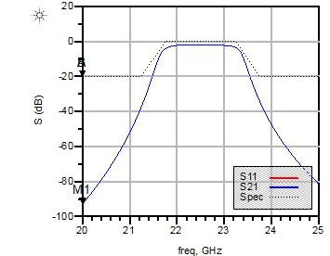
Simulation Result display

Slide 25
Schematic and Layout

Slide 26
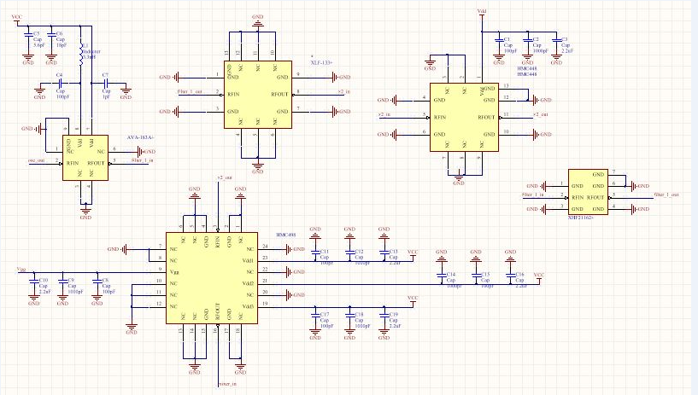
Schematic for the second solution of the LO path

Slide 27
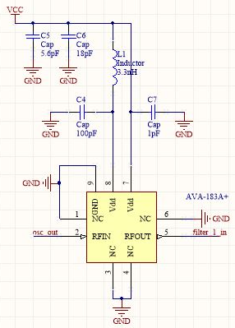
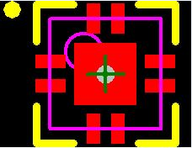
Schematic and footprint layout The first amplifier: AVA-183A+

Slide 28
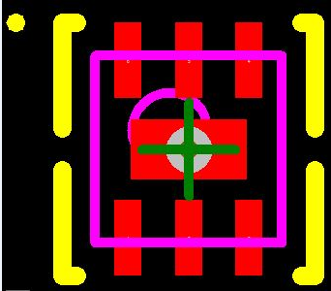
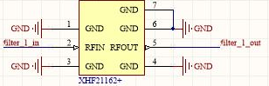
Schematic and footprint layout Highpass filter: XHF2-1162+

Slide 29
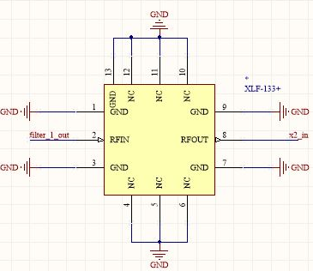
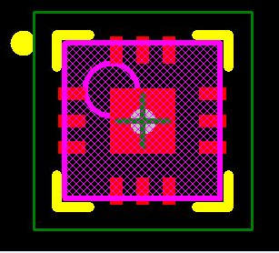
Schematic and footprint layout Lowpass Filter: XLF-123+

Slide 30
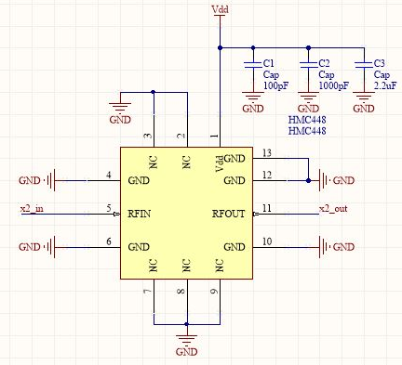
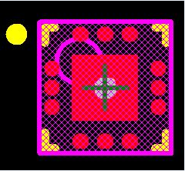
Schematic and footprint layout Multiplier: HMC448LC3B

Slide 31
Schematic and footprint layout Multiplier: HMC499LC4

Slide 32
PCBs

Slide 33
Testing Set-up
LO signal generator (added 6 dB attenuator)
Down conversion module
SA
High frequency signal generator

Slide 34
Testing Set-up
RF signal under test
(50-70 GHz)
RF
40 GHz signal generator
LO
The down-conversion module
IF
6 dB attenuator
SA

Slide 35
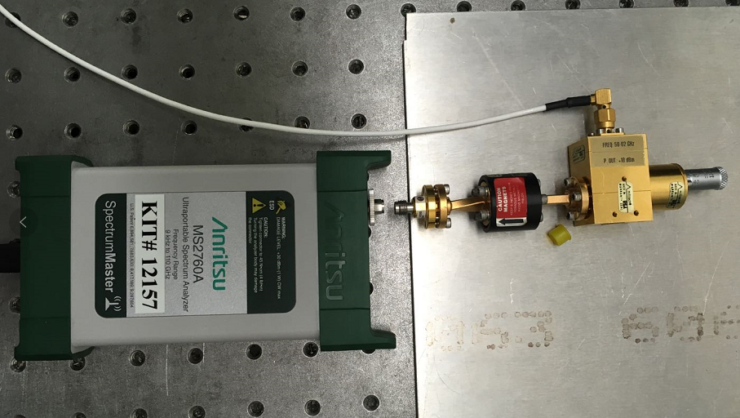
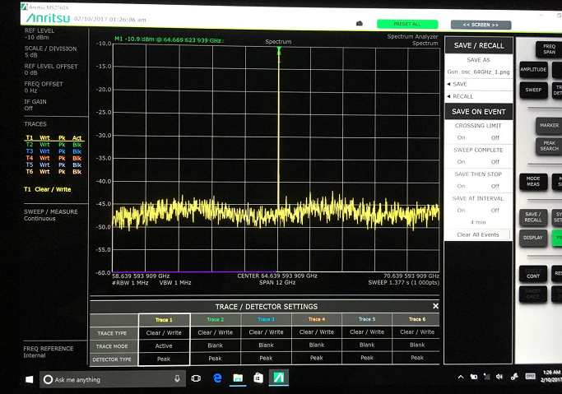
Set-up for characterizing the RF source
Display of the SA during the measurement.
High frequency SA
High frequency signal generator (58-62 GHz)

Slide 36
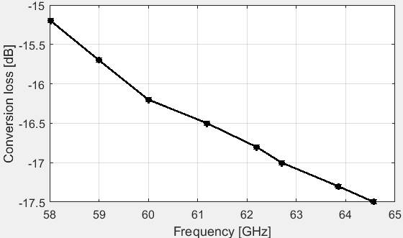
Conversion loss characterization
When the LO frequency was set to be 11.45 GHz, the transfer function has the maximum value.
Frequency:
Power:
RF input frequency [GHz] | RF input power [dBm] | IF output frequency [GHz] | IF output power[dBm] | Conversion loss [dB]
58.02 | 4.5 | 12.22 | -10.7 | -15.2
59 | -3.3 | 13.2 | -19.0 | -15.7
60 | 1.2 | 14.2 | -15.0 | -16.2
61.19 | -2.7 | 15.39 | -19.2 | -16.5
62.19 | 1.8 | 16.39 | -15.0 | -16.8
62.7 | 5.0 | 16.9 | -12.0 | -17.0
63.88 | -9.8 | 18.08 | -27.1 | -17.3
64.57 | -10.9 | 18.77 | -28.4 | -17.5

